Slide 1
Problem statement
IC HACK 2.0
This open innovation challenge invites individuals, teams, and organizations to contribute their
innovative ideas, projects, and initiatives aimed at mitigating and adapting to climate change.
The challenge is intentionally open-ended, allowing participants to explore diverse approaches
and ideas to combat climate change.
Team HACK ELITE+

Slide 2
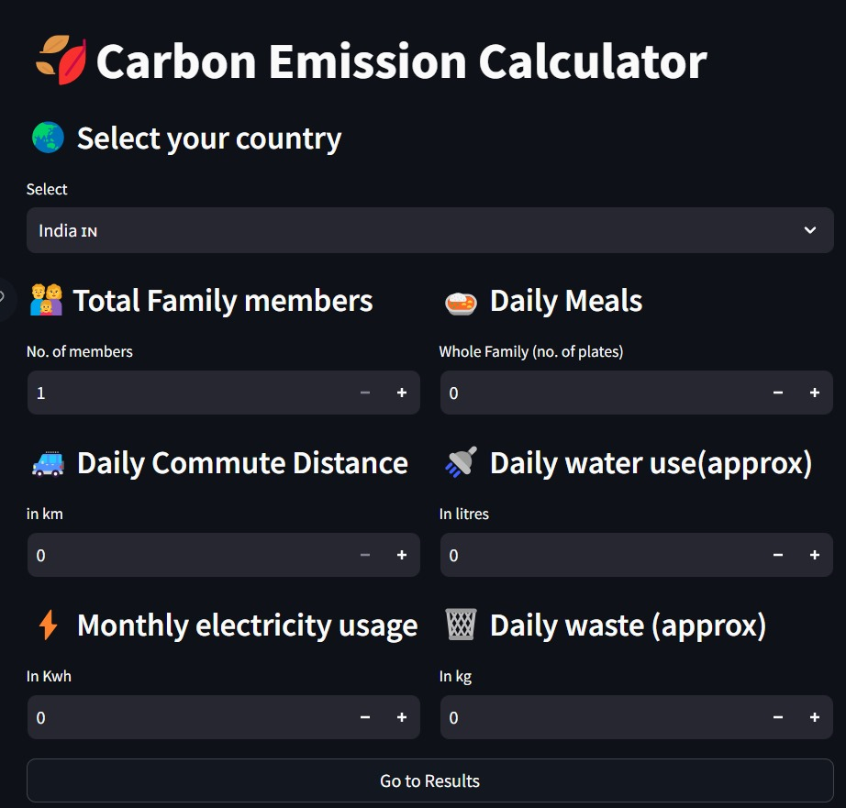
Introduction
Utilizing a carbon emission calculator as a means to mitigate climate change involves employing data and algorithms to approximate the carbon emissions of an entity. This estimation takes into account a range of factors, including energy usage, transportation patterns, and waste production. By providing pertinent details, individuals and organizations can acquire a deeper understanding of their impact on climate change and pinpoint strategies for diminishing their carbon footprint.

Slide 3

SCOPE OF SOLUTIONS
Reduction of greenhouse gas-emissions
Periodically reevaluate your carbon footprint using the calculator to assess whether you are meeting your reduction targets and make necessary adjustments.
Climate resilient and adaptation-strategies
Allocate resources for adaptation and resilience efforts based on the emissions data. Areas with high emissions and high vulnerability may require more substantial investments in climate-resilient infrastructure
Conservation and restoration of-ecosystems
Promote sustainable land use practices, such as agroforestry or sustainable agriculture, which not only reduce emissions but also protect and enhance ecosystems.

Slide 4

Climate awareness and education- programme
Provide participants with resources, including fact sheets, videos, and websites, that support their understanding of climate change and carbon reduction strategies.
Circular economy and waste reduction- initiatives.
Develop e-waste recycling and disposal programs to reduce the carbon footprint associated with electronic waste.
Sustainable energy solutions-
Invest in carbon offset projects, such as reforestation or methane capture from landfills, to compensate for emissions that cannot be eliminated through efficiency measures or renewable energy adoption. Calculate the emissions reductions achieved through offset projects.

Slide 5
UNIQUENESS OF THE CONCEPT IN CONTRAST TO ESTABLISHED ALTERNATIVES
Visual Data Comparison: Using a bar chart to compare data with global and national averages.
Tailored Emission Reduction Solutions: Customized solutions categorized by emissions reduction measures.
Sharing on Social Media: Disseminating results across various social media platforms.
Future AI Recommendations: Integrating artificial intelligence to enhance the program's capabilities for future requirements.

Slide 6
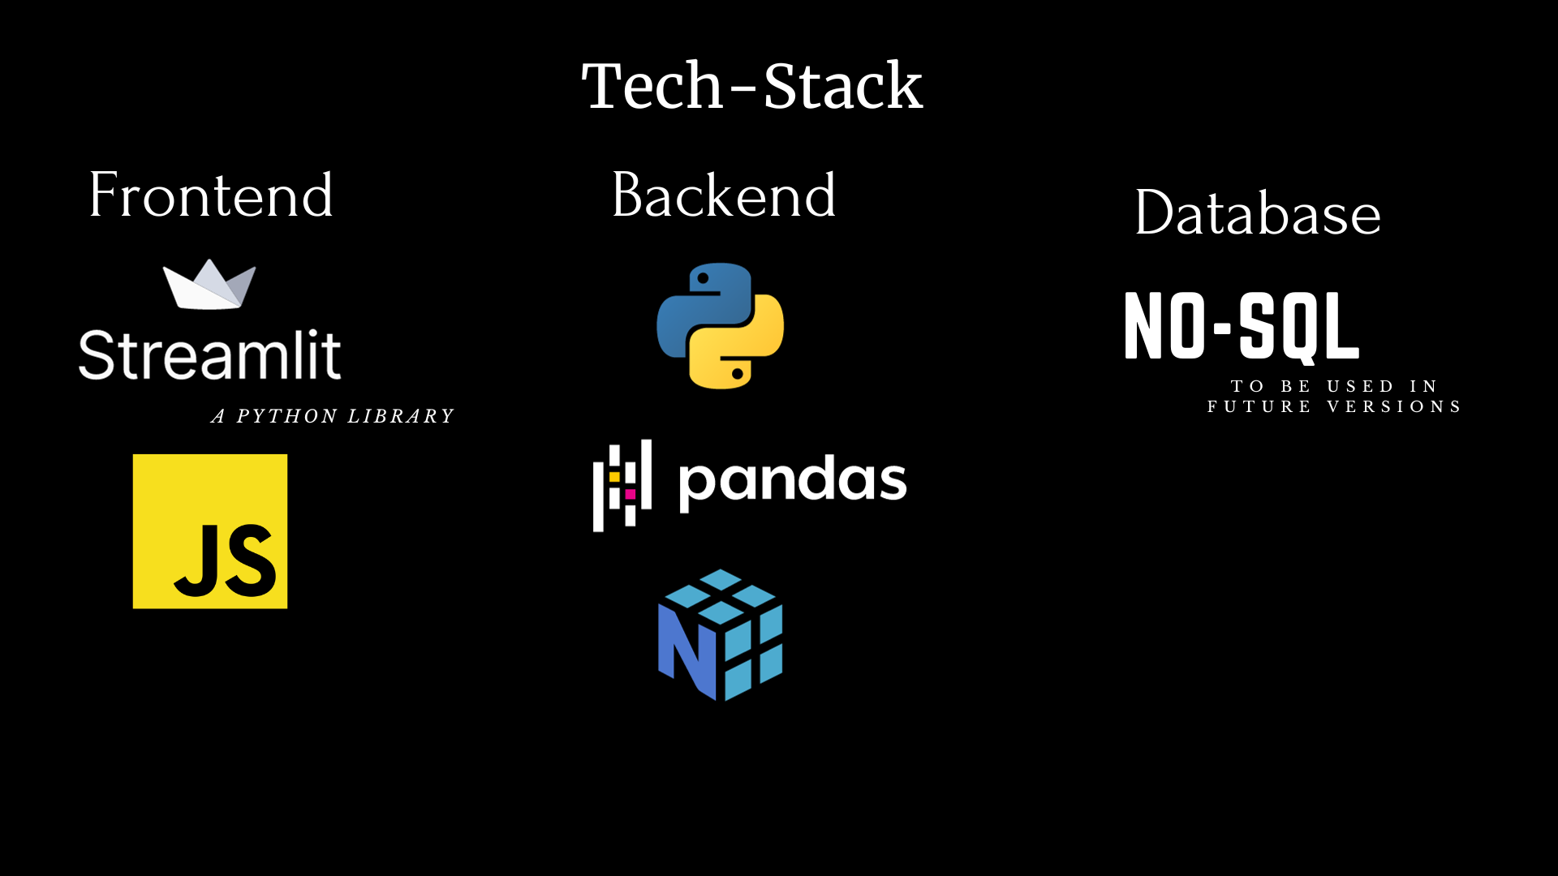

Slide 7
SCALABILITY
The prototype utilizes Python and JavaScript, making it user-friendly and equipped to efficiently manage high traffic volumes through effective algorithms. User Capacity: Scalability guarantees the ability to cater to a large number of users simultaneously, even during periods of peak demand. Enhanced Sophistication: While the calculator becomes more advanced, it should continue to operate seamlessly. This might entail incorporating more intricate calculations, utilizing advanced modeling methods, or introducing extra features without compromising efficiency. Adaptability: A scalable calculator should have the flexibility to adjust to diverse contexts and usage scenarios, accommodating a wide array of emission sources, industries, and geographical regions. Monitoring and Scaling Approaches: The deployment of monitoring tools and automatic scaling techniques can assist in upholding performance during usage surges and minimizing expenses during periods of reduced demand.

Slide 8
SCALE OF IMPACT
Primarily, the user would typically be an individual or household.
With individual contributions accounting for approximately 70-75%, the resulting impact is expected to be significant.
The result presented incorporates a strong element of social awareness.
The model will actively inform individuals about the implications of their emissions on the world and society.

Slide 9
ABOUT THE TEAM
TEAM NAME: Hack Elite+
MEMBERS:
KRISHNAV KANOI
ADITYA KUMAR JHA
ADITYA ANJANA
PRANAV RANA

